Slide 1
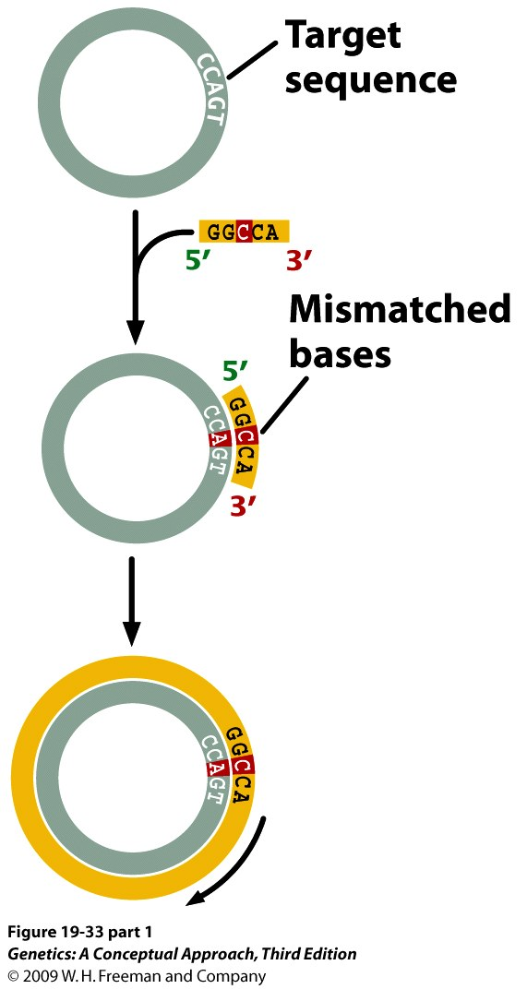
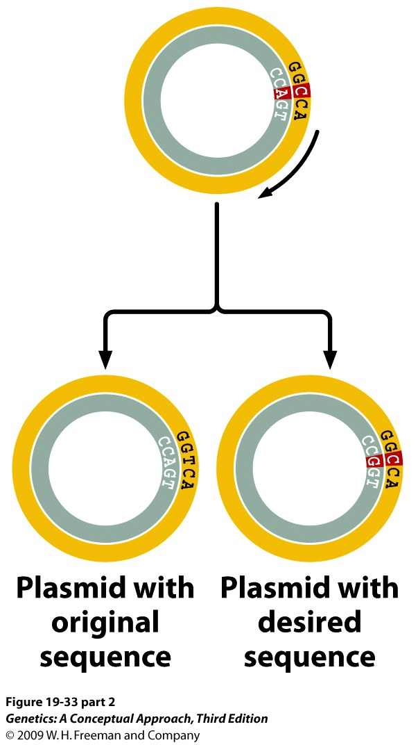
Site-directed mutagenesis
Notes:
19.33 (part 1) Oligonucleotide-directed mutagenesis is used to study gene function when appropriate restriction sites are not available.

Slide 2

Polymerase Chain Reaction (PCR)
PCR copies a specific DNA sequence through in vitro reactions that can amplify target DNA sequences present in very small quantities.
PCR requires two oligonucleotide primers, one complementary to the 3' end of one strand of the DNA to be amplified and one complementary to the 3' end of the other strand.
The primers anneal to denatured DNA, and the complementary strands are synthesized by a heat-stable DNA polymerase.
The three steps of PCR - denaturation, primer annealing, and extension—are repeated over and over to amplify the DNA exponentially.

Slide 3
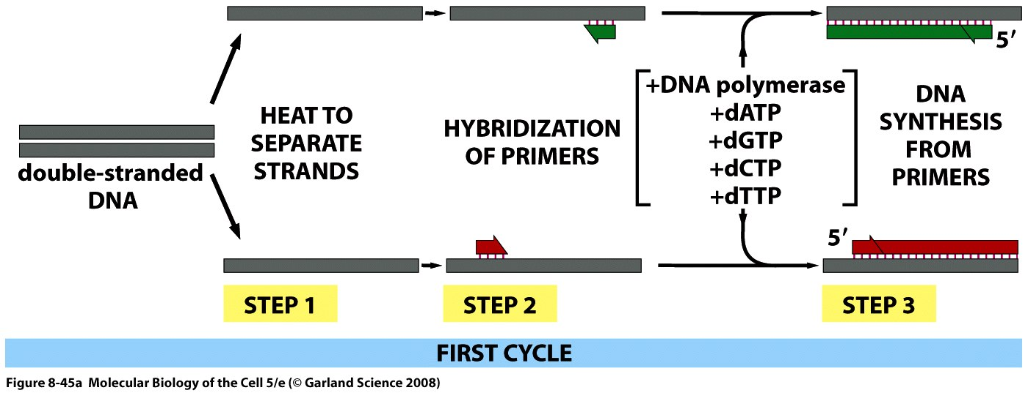
The first round of PCR
94°C
37-65°C
70-75°C

Slide 4
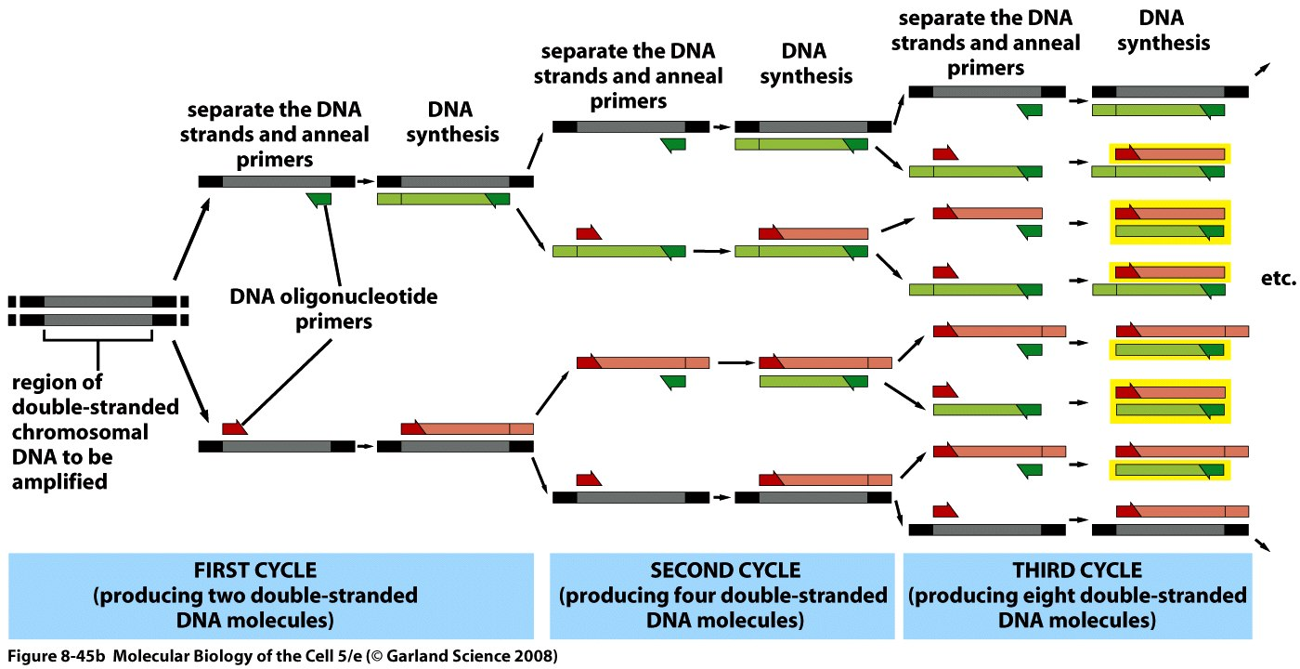
PCR increases the yield of DNA exponentially

Slide 5
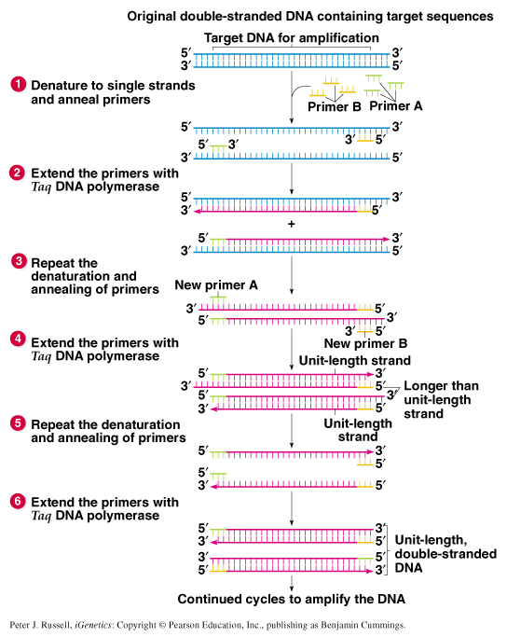
A typical PCR protocol
Begins with DNA containing a sequence to be amplified and a pair of synthetic oligonucleotide primers that flank the sequence.
Next, denature the DNA to single strands at 94˚C.
Rapidly cool the DNA (37-65˚C) and anneal primers to complementary single strand sequences flanking the target DNA.
Extend primers at 70-75˚C using a heat-resistant DNA polymerase such as Taq polymerase derived from Thermus aquaticus.
Repeat the cycle of denaturing, annealing, and extension 20-45 times to produce 1 million (2²⁰) to 35 trillion copies (2⁴⁵) of the target DNA.
Extend the primers at 70-75˚C once more to allow incomplete extension products in the reaction mixture to extend completely.
Cool to 4˚C and store or use amplified PCR product for analysis.

Slide 6

PCR in Medicine
Since 1987, PCR has had a major impact on prenatal diagnosis of single gene disorders.
Also very important in carrier testing for genetic diseases.
Improved speed, accuracy and technical flexibility over previous methods.

Slide 7
PCR to detect HIV
PCR allows the direct detection of HIV genomes in patient blood before the appearance of HIV antibodies.
viral DNA/RNA only represents a minute proportion of total cell DNA.
Only a small fraction of blood cells are infected (1/10,000).
also require high degree of specificity while targeting conserved regions of DNA to guard against high level of genetic variability characteristic of retroviruses.
High risk of cross-contaminating sample with small amounts of amplified DNA from previous sample requires extra precautions to prevent false-positives.
PCR can detect 10-20 copies of viral DNA from 150,000 human cells.

Slide 8
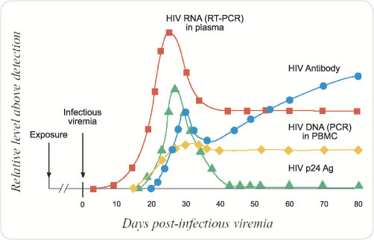
PCR to detect HIV

Slide 9
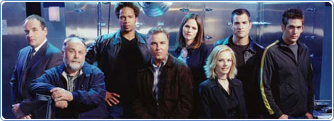
PCR in Forensics
Crucial forensic evidence may be present in very small quantities.
often too little material for direct DNA analysis.
but PCR can generate sufficient DNA from a single cell.
PCR also possible on extensively degraded DNA.
examples include DNA from single dried blood spot, saliva (on cigarette butt), semen, tissue from under fingernails, hair roots.
Other advantages of PCR in forensic science are:
relatively simple to perform and simple to standardize.
results obtainable within 24 hours.
The major legal problems with PCR are the potential for cross-contamination between samples and the complexity of explaining what the results mean to the jury.

Slide 10
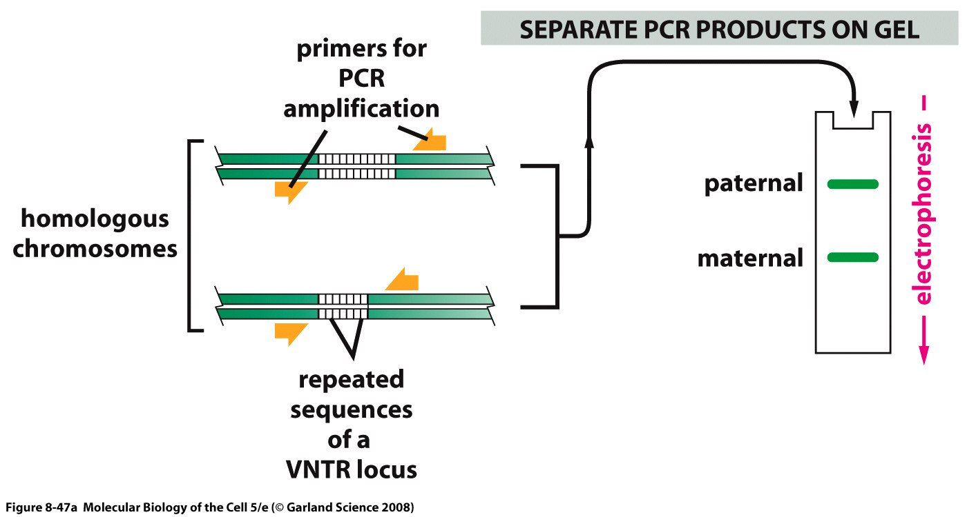
Variable Number of Tandem Repeat (VNTR) analysis is commonly used in forensics
VNTR is based on hypervariable microsatellite sequence polymorphisms within the human genome. These sequences (e.g., CACACA …) are found in many locations in the human genome and vary greatly from person to person.

Slide 11
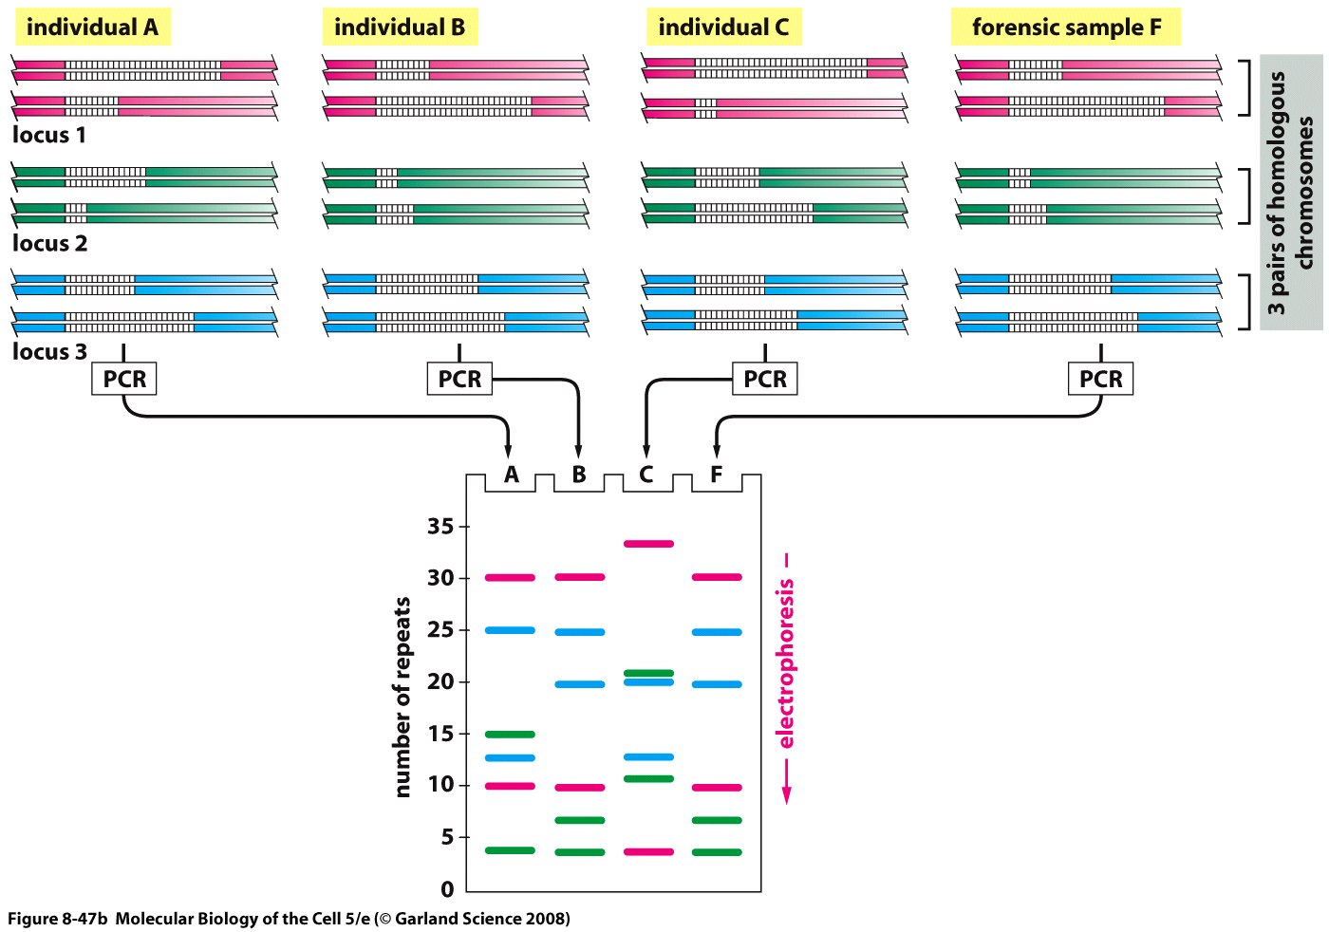
Using VNTR to compare forensic and suspect samples
Individuals A & C are excluded by this analysis. The samples from individual B will be subjected to further tests.

Slide 12
DNA Sequencing
The most common method of DNA sequencing is dideoxy chain termination sequencing, developed by Sanger.
Maxam-Gilbert’s chemical method.
Next generation sequencing.

Slide 13
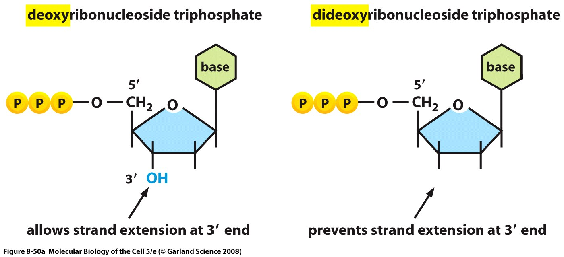
Dideoxy NTPs block DNA synthesis
H

Slide 14
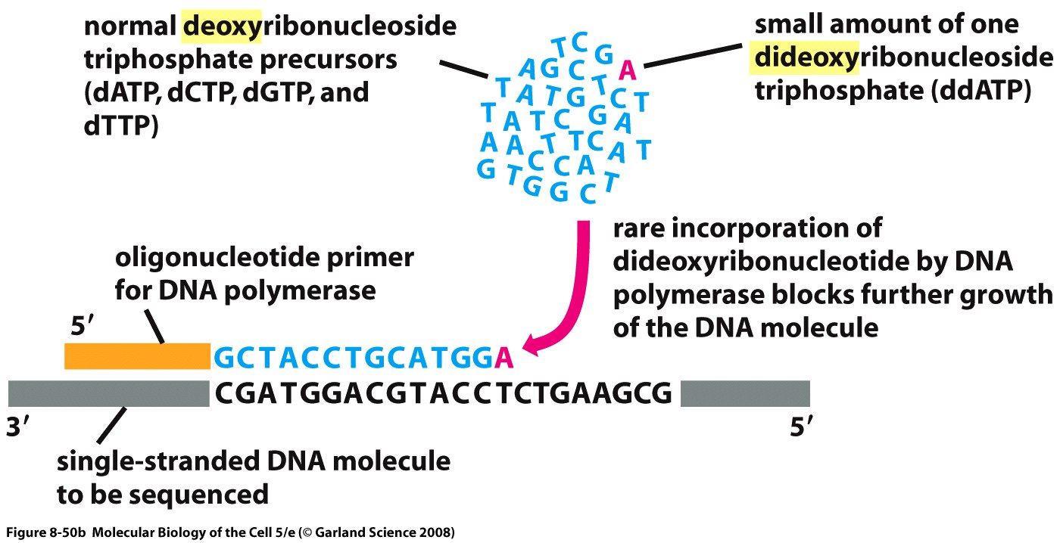
A mixture of dNTPs and ddNTPs are used in DNA sequencing

Slide 15
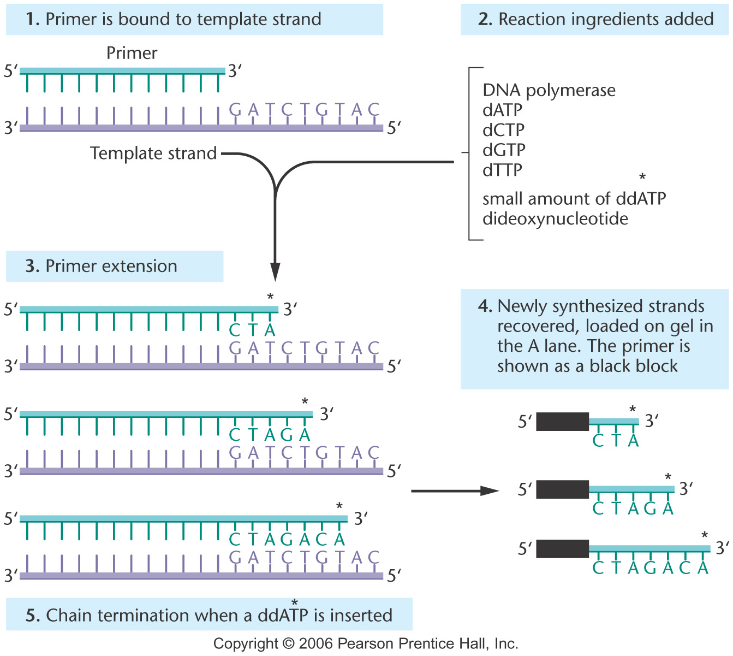
Notes:
Figure 19-26 DNA sequencing using the chain termination method. (1) A primer is annealed to a sequence adjacent to the DNA being sequenced (usually at the insertion site of a cloning vector). (2) A reaction mixture is added to the primer–template combination. This includes DNA polymerase, the four dNTPs (one of which is radioactively labeled) and a small amount of one dideoxynucleotide. Four tubes are used, each containing a different dideoxynucleotide (ddATP, ddCTP, etc.). (3) During primer extension, the polymerase occasionally inserts a ddNTP instead of a dNTP, terminating the synthesis of the chain, because the ddNTP does not have the -OH group needed to attach the next nucleotide. In the figure, ddATP and the A inserted from this dideoxynucleotide are indicated with an asterisk. Over the course of the reaction, all possible termination sites will have a ddNTP inserted. (4) The newly synthesized strands are removed from the template, and the mixture is placed on a gel. DNA fragments from the reaction tube containing ddATP and terminating with A are loaded in the A lane, those ending in C are loaded in the C lane, and so forth.

Slide 16
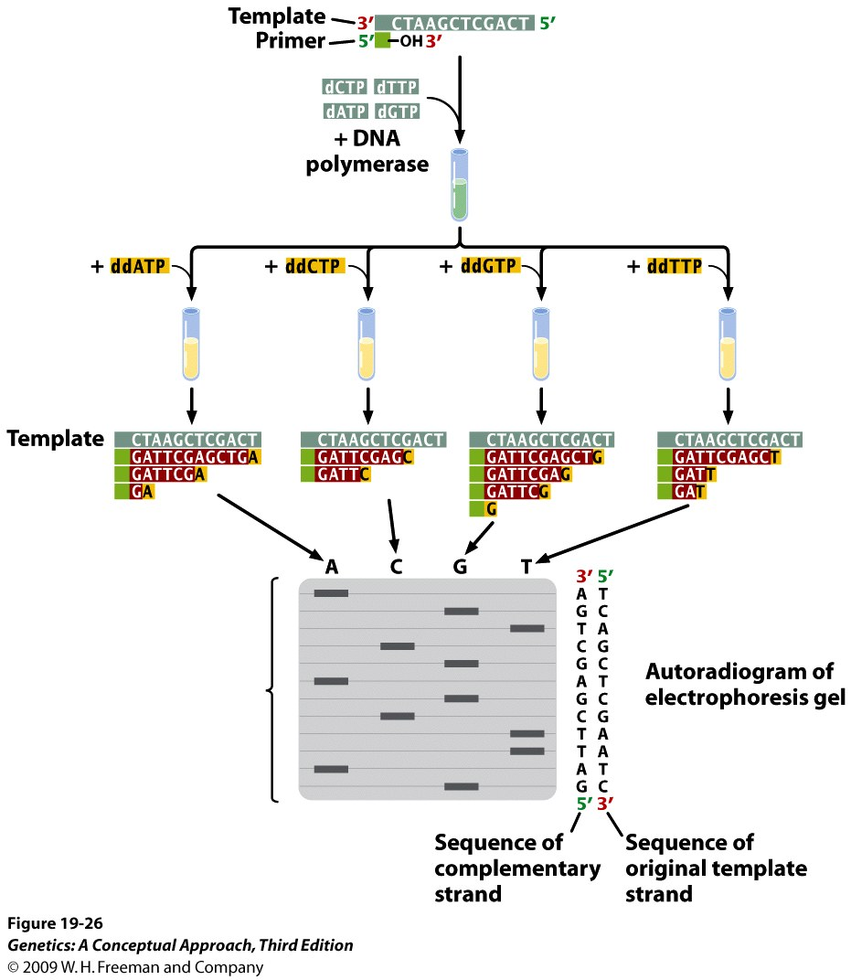
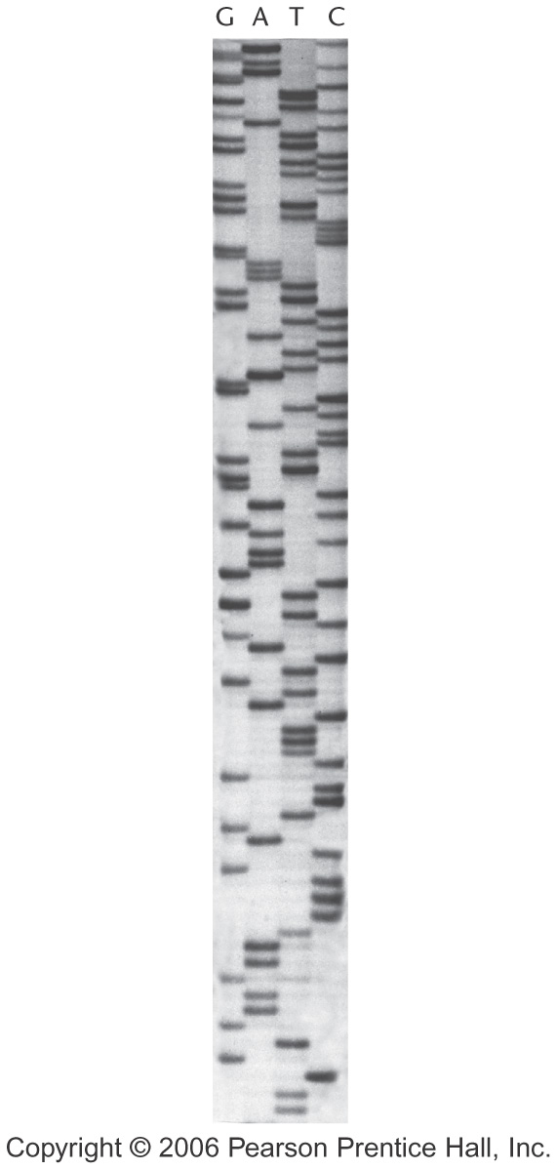
Notes:
19.26 The dideoxy method of DNA sequencing is based on the termination of DNA synthesis.

Slide 17
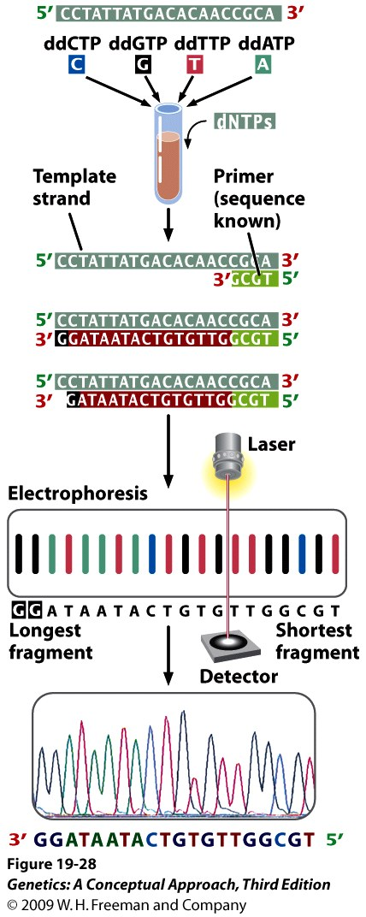
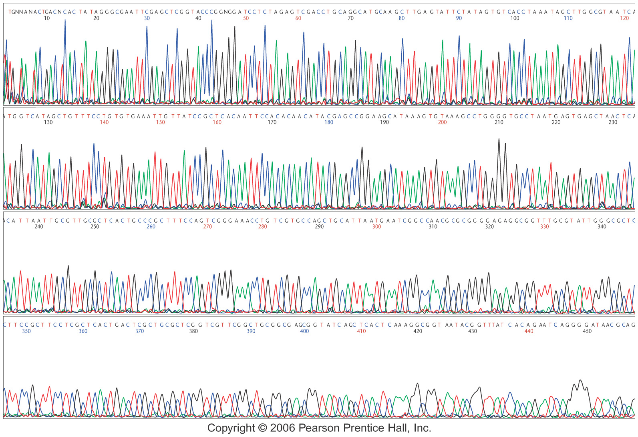
DNA sequencing
Large-scale genome sequencing is automated and uses fluorescent dye–labeled dideoxynucleotides.
Notes:
19.28 The dideoxy sequencing method can be automated.

Slide 18
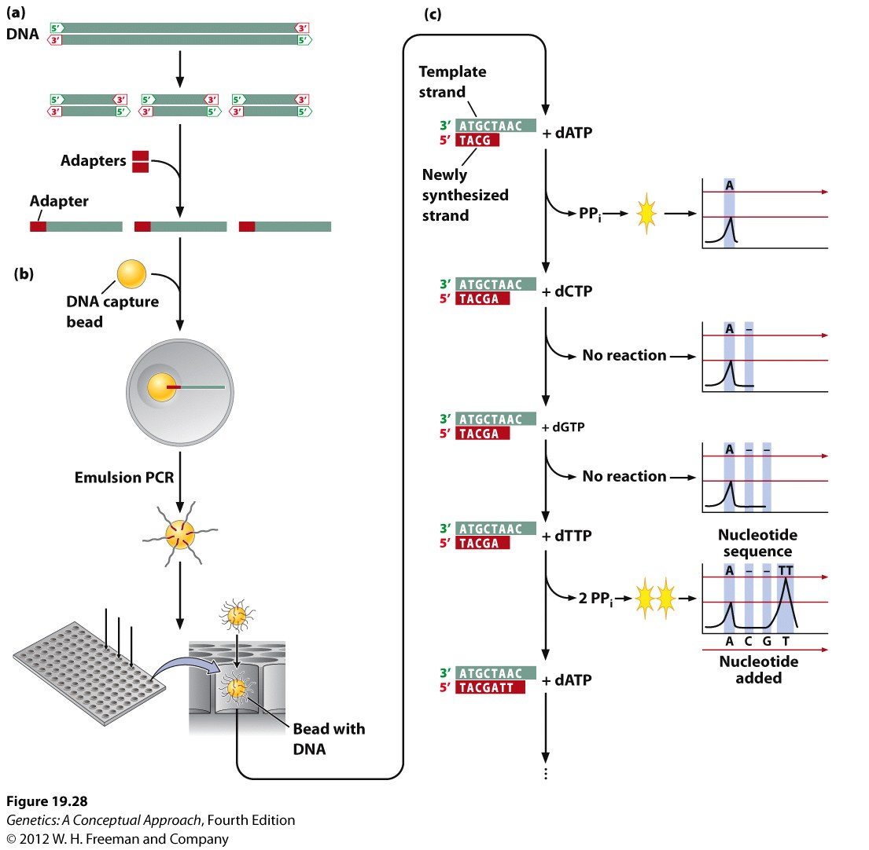
Next Generation Sequencing

Slide 19
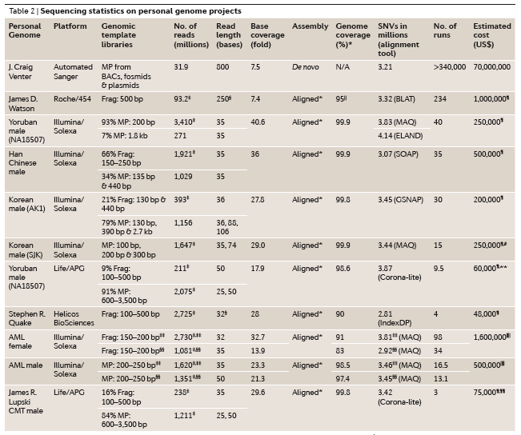
Personalized genome project

Slide 20
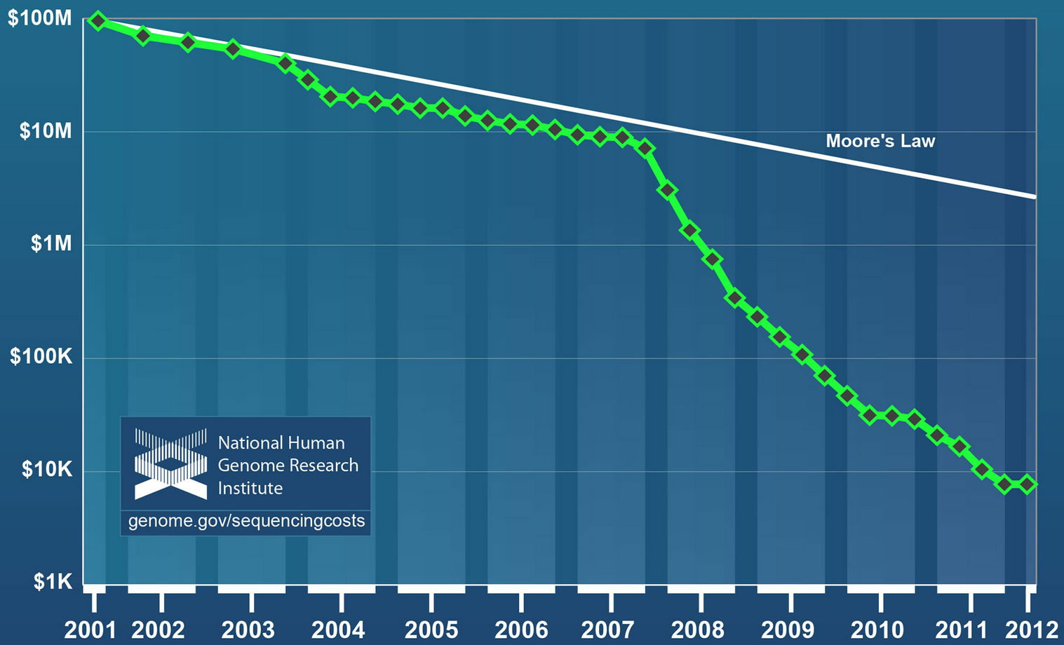
Cost of sequencing human genome

